Slide 1
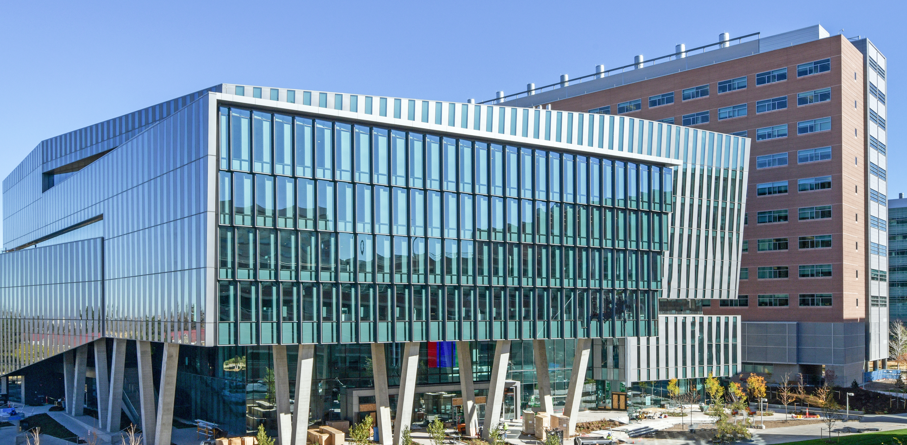


Predicting Intracranial Pressure Monitor Placement in Children with Traumatic Brain Injury
Seth Russell, MS
Peter E. DeWitt, Ph.D.
useR!
Aug 2025
Bringing Sight to Life

Slide 2
Disclosures
This work was supported by:
Mindsource Brain Injury Network of the Colorado Department of Human Services, PI Tell Bennett
Eunice Kennedy Shriver National Institute for Child Health and Human Development, grant R03 HD094912, PI Tell Bennett
This work has been accepted for publication in a peer reviewed journal. Publication date pending.
Team of people contributed to this work:
Laura Helmkamp, MS; Kathryn Colborn PhD, MSPH; Charlotte Gray, MPH; Margaret Rebull, MA; Yamila L. Sierra, MPH; Rachel Greer, BA; Lexi Petruccelli, BA; Sara Shankman, CPNP-AC, DNP; Todd C. Hankinson, MD, MBA; Fuyong Xing, PhD; David J. Albers, PhD; and Tellen D. Bennett, MD, MS
https://github.com/magic-lantern/2025-useR

Slide 3
Motivation
Traumatic Brain Injury - A violent blow or jolt to the head or body that can cause temporary or permanent complications up to death. Swelling is a common serious complication.
Annually in the United States, traumatic brain injury causes:
2,200 pediatric deaths
35,000 pediatric hospitalizations
To monitor and track brain swelling, an invasive procedure is performed to install a device called an Intercranial Pressure Monitor (ICP) into the skull. Clinicians currently make decisions about ICP placement with traumatic brain injury without the benefit of an accurate clinical decision support tool
https://github.com/magic-lantern/2025-useR

Slide 4
Study
Aim - Develop and validate model(s) that predict placement of an ICP monitor. Models should update individual predictions as new information becomes available during an Intensive Care Unit (ICU) stay.
Study
Prospective observational cohort study: September 2014 - January 2024
389 children with acute traumatic brain injury admitted to the ICU
138 (35%) of the 389 participants received ICP monitoring.
Approved and granted a waiver of consent by the Colorado Multiple Institutional Review Board
https://github.com/magic-lantern/2025-useR

Slide 5
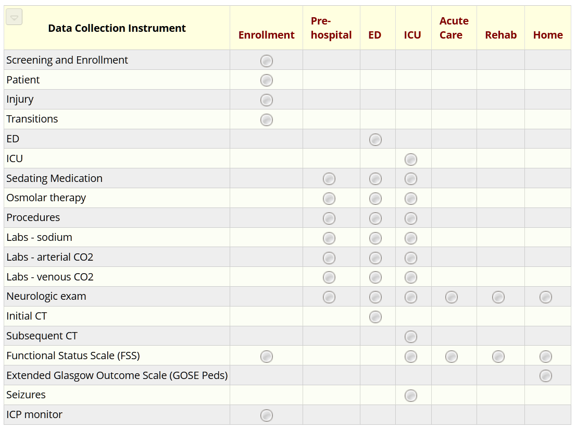
Data
REDCap
EHR
record_id | vital | Units | Value | Datetime
1 | pulse | bpm | 90 | 2027-01-01 13:01
1 | pulse oximetry | % | 98 | 2027-01-01 13:01
1 | respirations |  | 24 | 2027-01-01 13:01
1 | pulse | bpm | 91 | 2027-01-01 14:01
https://github.com/magic-lantern/2025-useR
In csv form, REDCap data is 276 columns wide

Slide 6
Data
Electronic Health Record
REDCap
Manually Collected data
Last Observation
Carry Forward
record_id | time | ICP | age | lab_co2 | pulse | …
1 | 0 | 0 | 13.1 | 40 | 120
1 | 5 | 0 | 13.1 | 40 | 120
1 | 10 | 0 | 13.1 | 40 | 121
1 | 15 | 0 | 13.1 | 45 | 121
Healthy default filled in for NULL
Plus more Data and Feature Engineering ~35 variables, 270k rows
https://github.com/magic-lantern/2025-useR

Slide 7
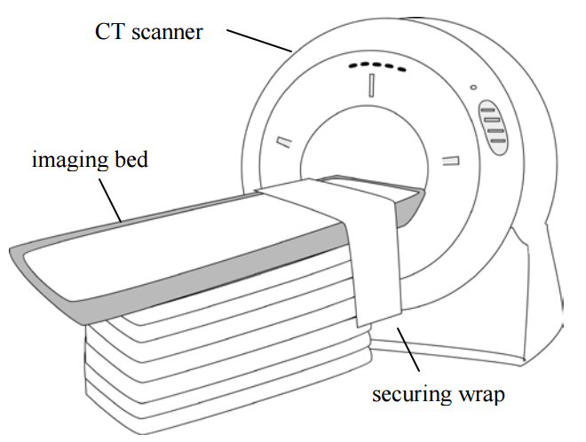
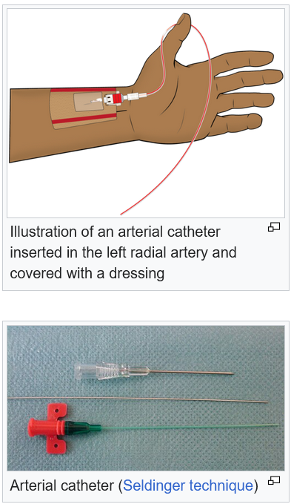
Data
Exclude/include CT extracted features and exclude/include Invasive BP
https://github.com/magic-lantern/2025-useR

Slide 8
Data
Exclude CT extracted features and exclude Invasive BP
Include CT extracted features and exclude Invasive BP
record_id | time | ICP | age | lab_co2 | pulse | …
1 | 0 | 0 | 13.1 | 40 | 120
1 | 5 | 0 | 13.1 | 40 | 120
1 | 10 | 0 | 13.1 | 40 | 121
1 | 15 | 0 | 13.1 | 45 | 121
record_id | time | ICP | age | lab_co2 | ct_fracture.factor | ct_ … | ct_ … | … | …
1 | 0 | 0 | 13.1 | 40 | 0
1 | 5 | 0 | 13.1 | 40 | 0
1 | 10 | 0 | 13.1 | 40 | 0
1 | 15 | 0 | 13.1 | 45 | 0
Exclude CT extracted features and include Invasive BP
Include CT extracted features and include Invasive BP
record_id | time | ICP | age | lab_co2 | inv_bp_available | …
1 | 0 | 0 | 13.1 | 40 | 0
1 | 5 | 0 | 13.1 | 40 | 0
1 | 10 | 0 | 13.1 | 40 | 0
1 | 15 | 0 | 13.1 | 45 | 1
record_id | time | ICP | age | ct_fracture.factor | ct_ … | ct_ … | inv_bp_available | …
1 | 0 | 0 | 13.1 | 0 |  |  | 0
1 | 5 | 0 | 13.1 | 0 |  |  | 0
1 | 10 | 0 | 13.1 | 0 |  |  | 0
1 | 15 | 0 | 13.1 | 0 |  |  | 1
Additionally split data temporally into training and testing datasets
Moons KGM, Altman DG, Reitsma JB, et al. Transparent Reporting of a multivariable prediction model for Individual Prognosis or Diagnosis (TRIPOD): explanation and elaboration. Ann Intern Med. 2015;162:W1-73. doi: 10.7326/M14-0698
https://github.com/magic-lantern/2025-useR

Slide 9
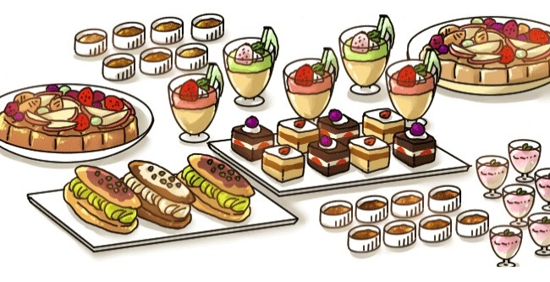
Modeling
Standard logistic regression
Penalized logistic regression (lasso & ridge)
Support vector machines (SVM)
Generalized estimating equations
Generalized additive models
Neural Network (NN) with Long Short-Term Memory layers (LSTM)
https://clipground.com/images/food-buffet-clipart-3.jpg
https://github.com/magic-lantern/2025-useR

Slide 10
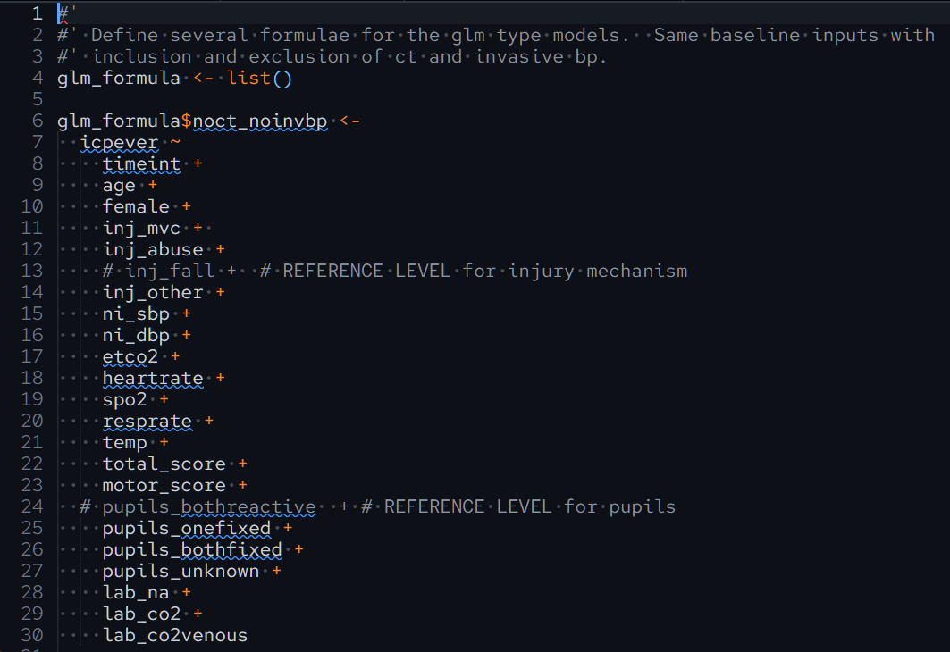
Modeling – Regression p1

Slide 11
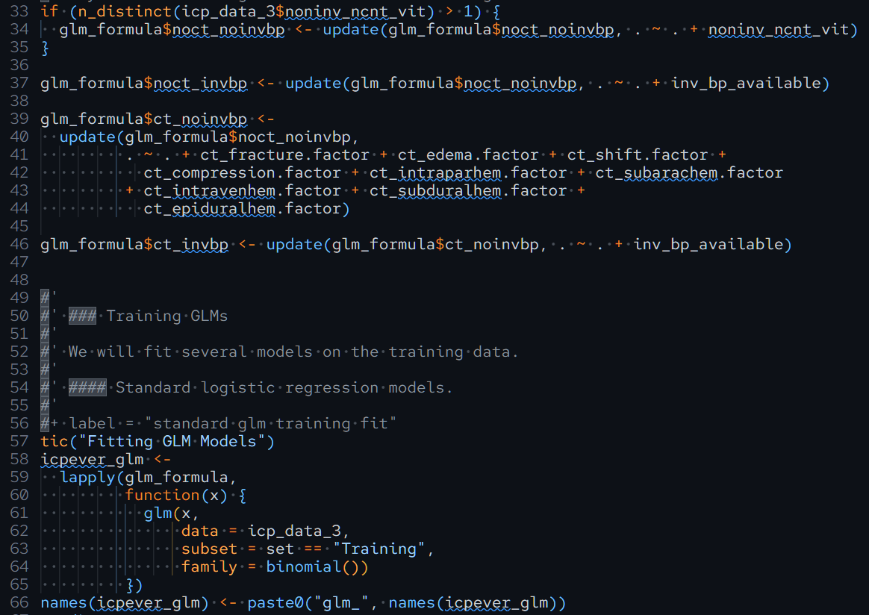
Modeling – Regression p2

Slide 12
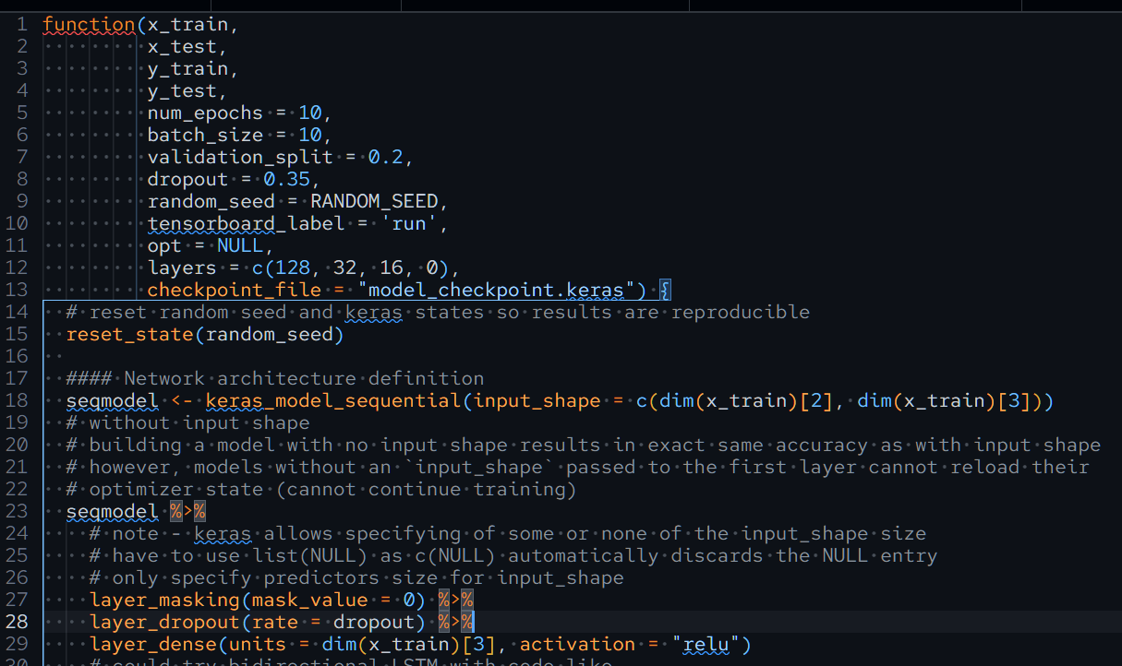
Modeling – LSTM p1

Slide 13
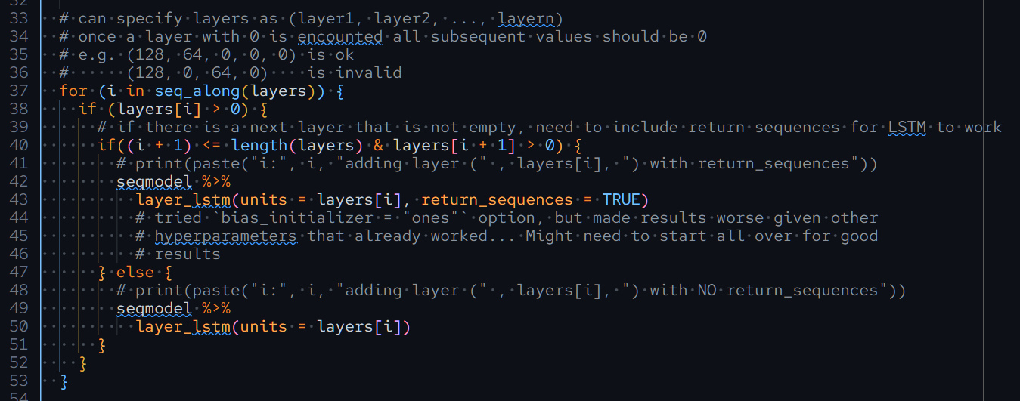
Modeling – LSTM p2
https://github.com/magic-lantern/2025-useR

Slide 14
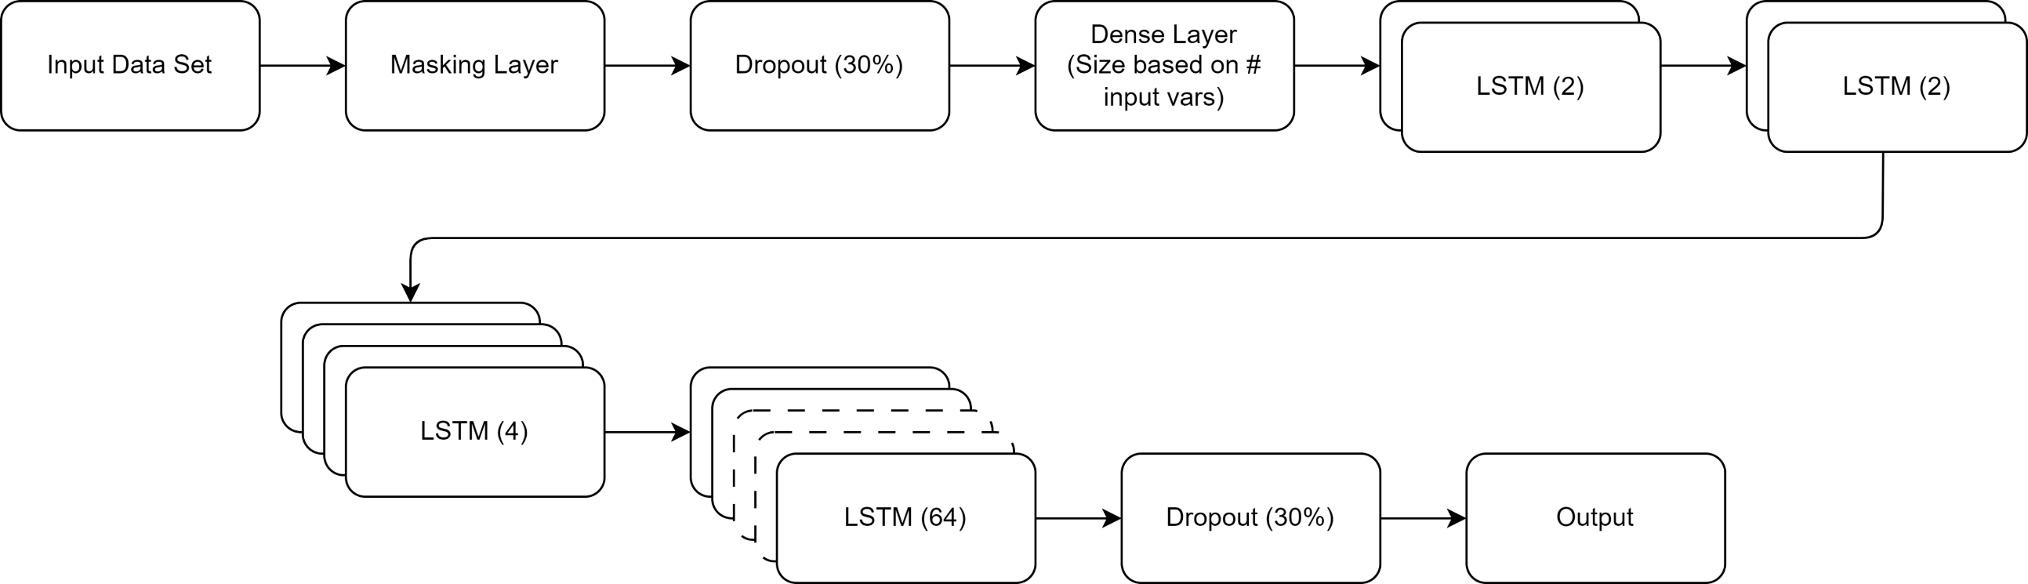
Modeling – LSTM p4
https://github.com/magic-lantern/2025-useR

Slide 15
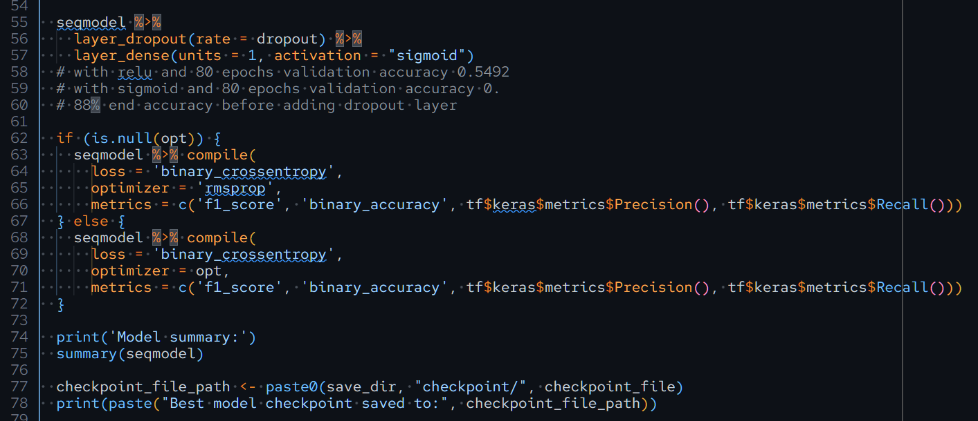
Modeling – LSTM p3
https://github.com/magic-lantern/2025-useR

Slide 16
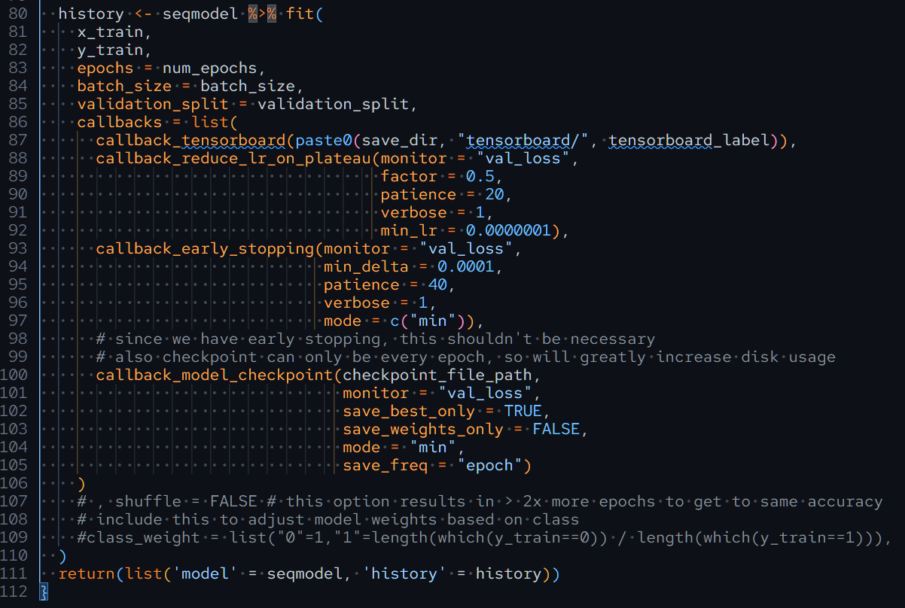
Modeling – LSTM p5

Slide 17
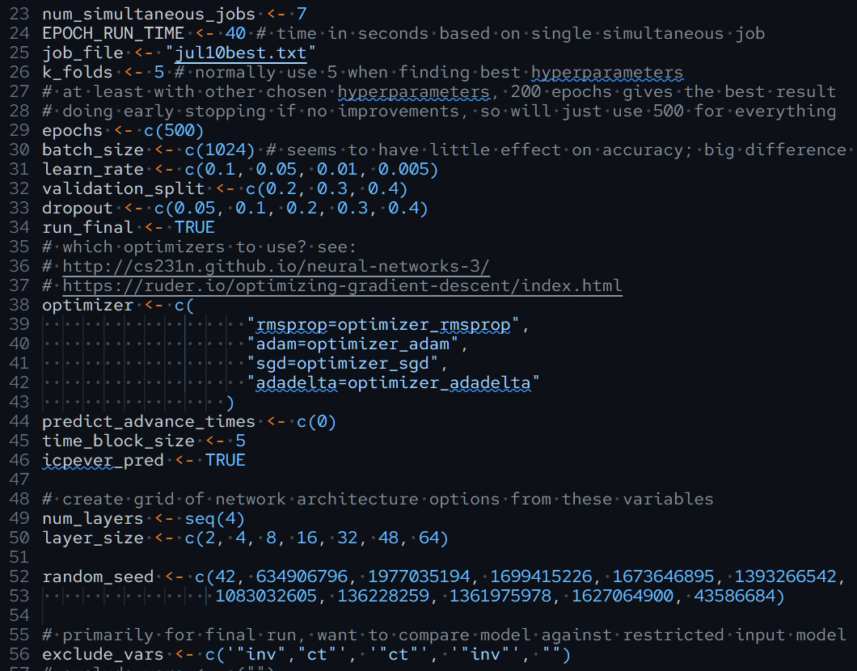
Modeling LSTM Hyperparameters
29,568,000 combinations

Slide 18
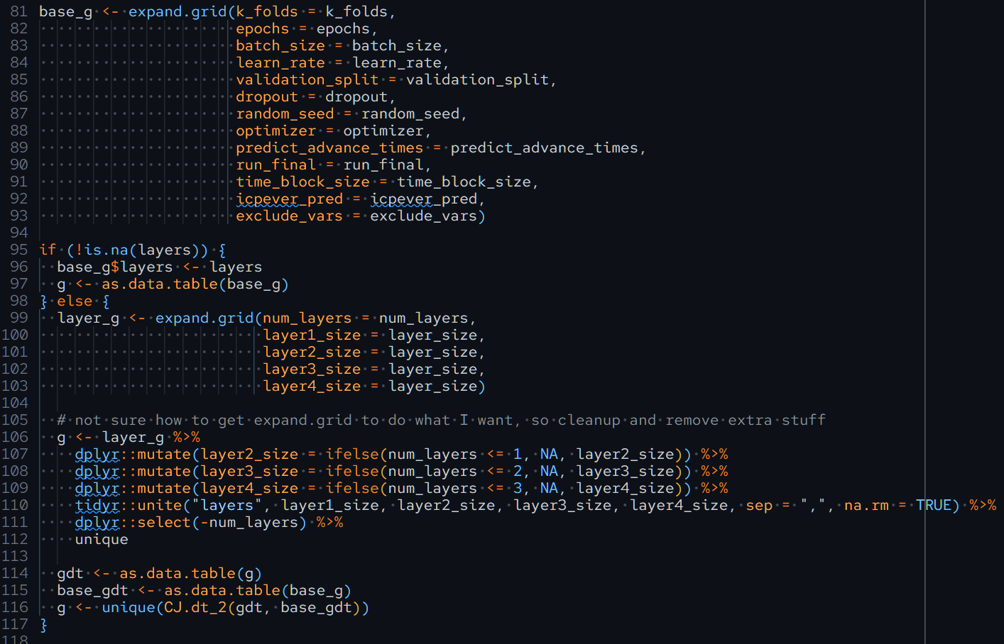
Modeling - LSTM hyperparm

Slide 19
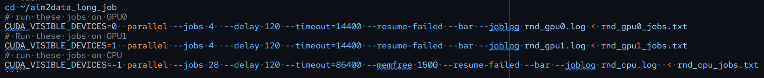
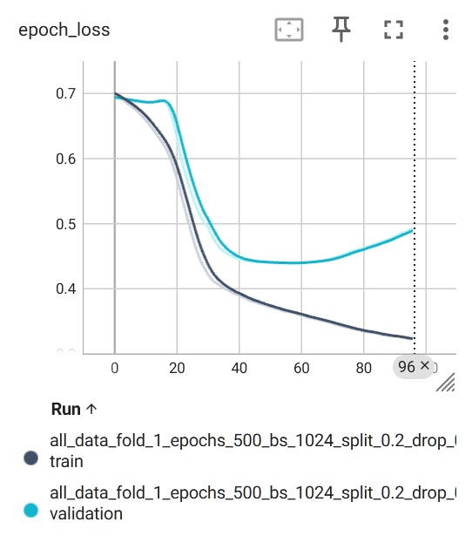

Modeling – LSTM training
(4) Intel Xeon Gold 6416H 'Sapphire Rapids-SP' 2.2 GHz 18-core CPU
(32) 64GB (~2TB) DDR5 4800 MHz ECC/Registered Memory
(2) NVIDIA "Ampere" A100 PCI-E+NVLink 80GB
(4) 7.68TB Intel SSD D3-S4520 2.5" SATA 6Gbps
(1) 15.36TB Micron 9400 PRO 2.5" U.3 NVMe SSD

Slide 20
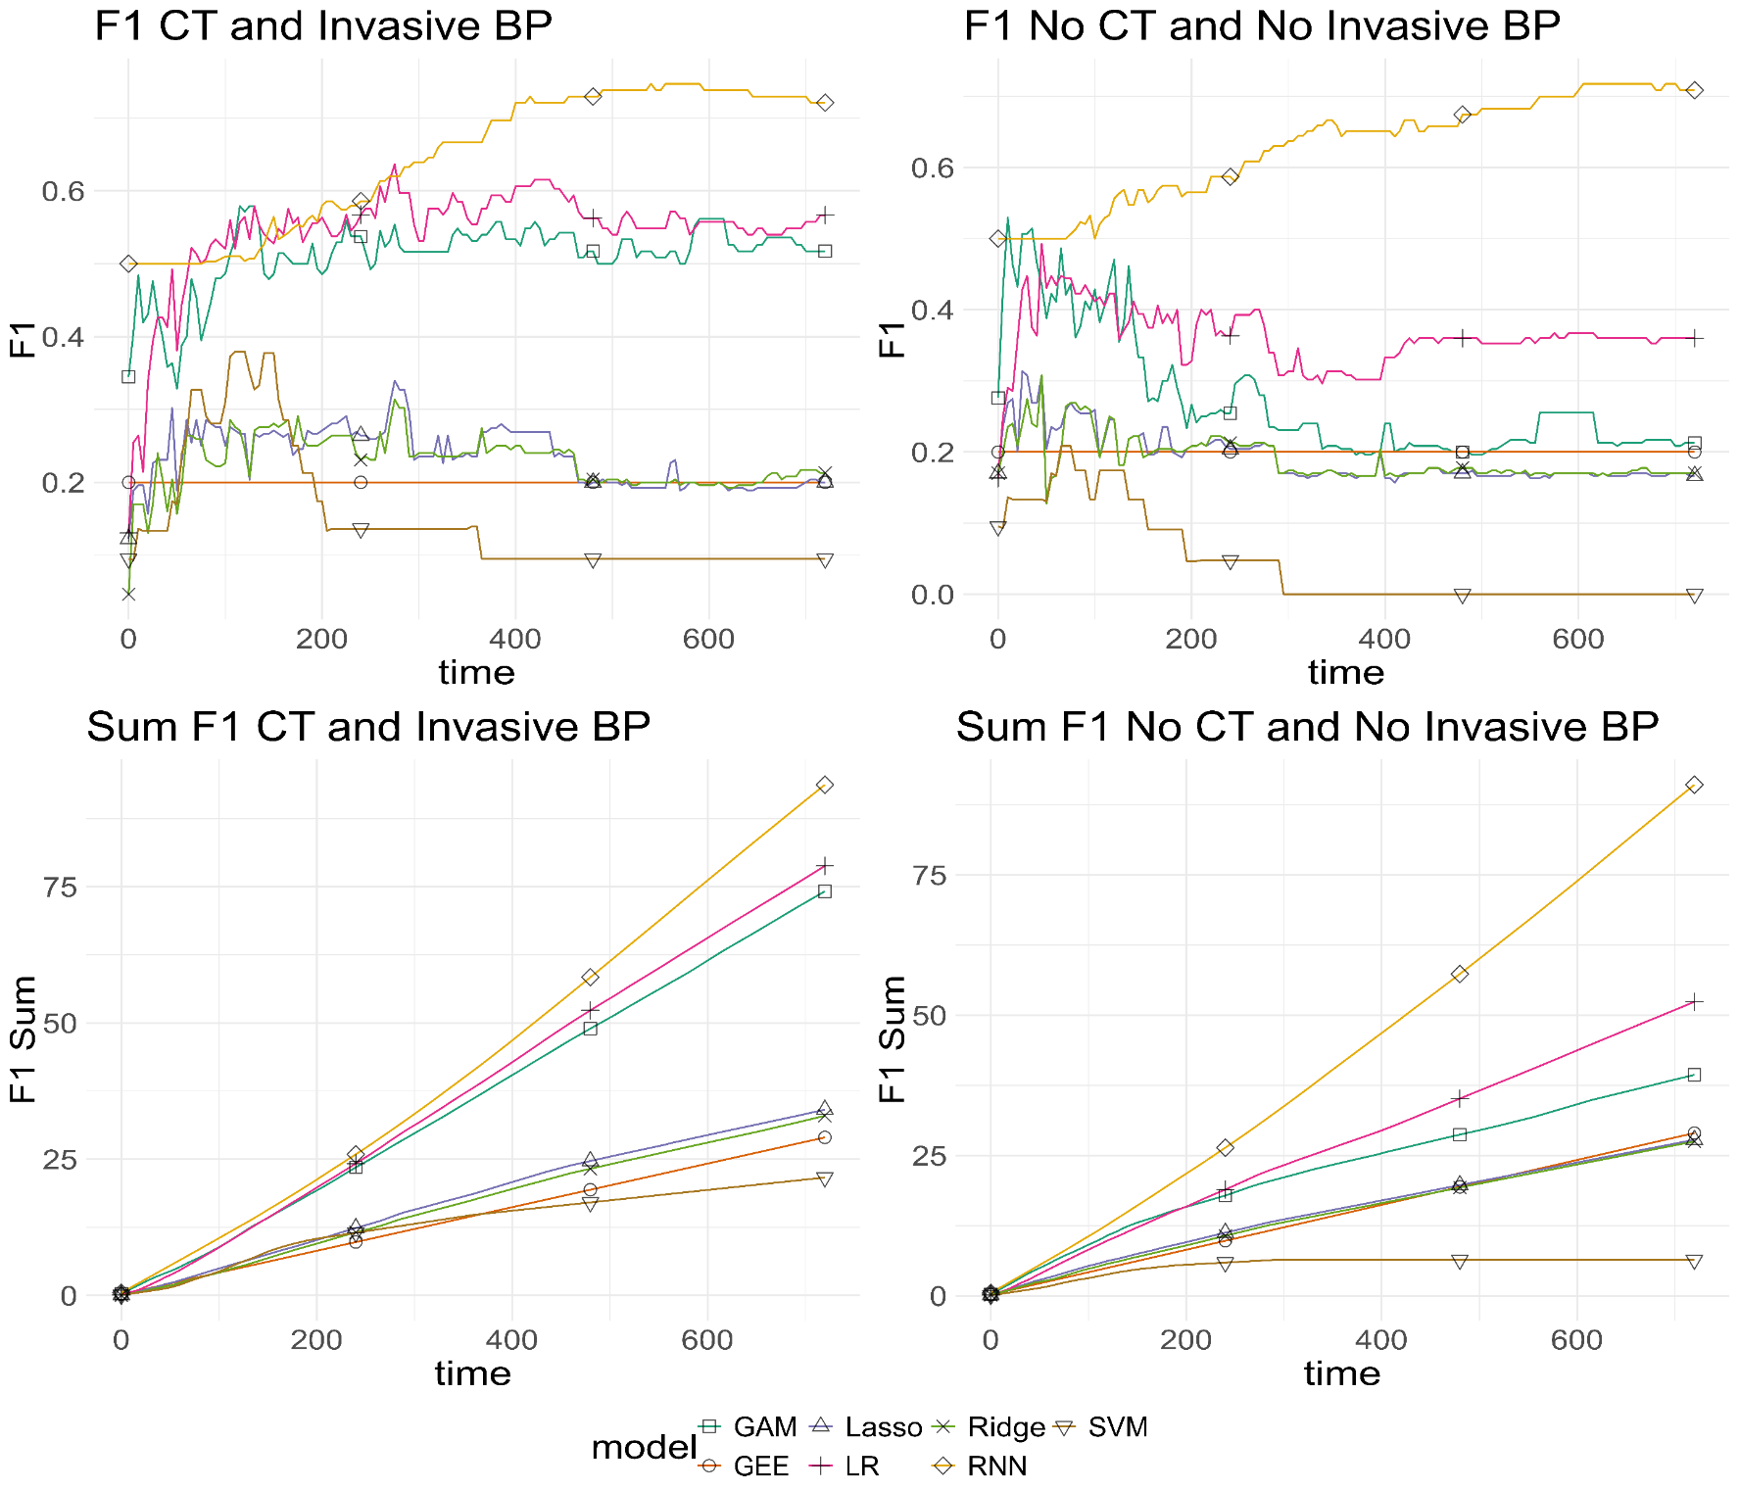
Results

Slide 21
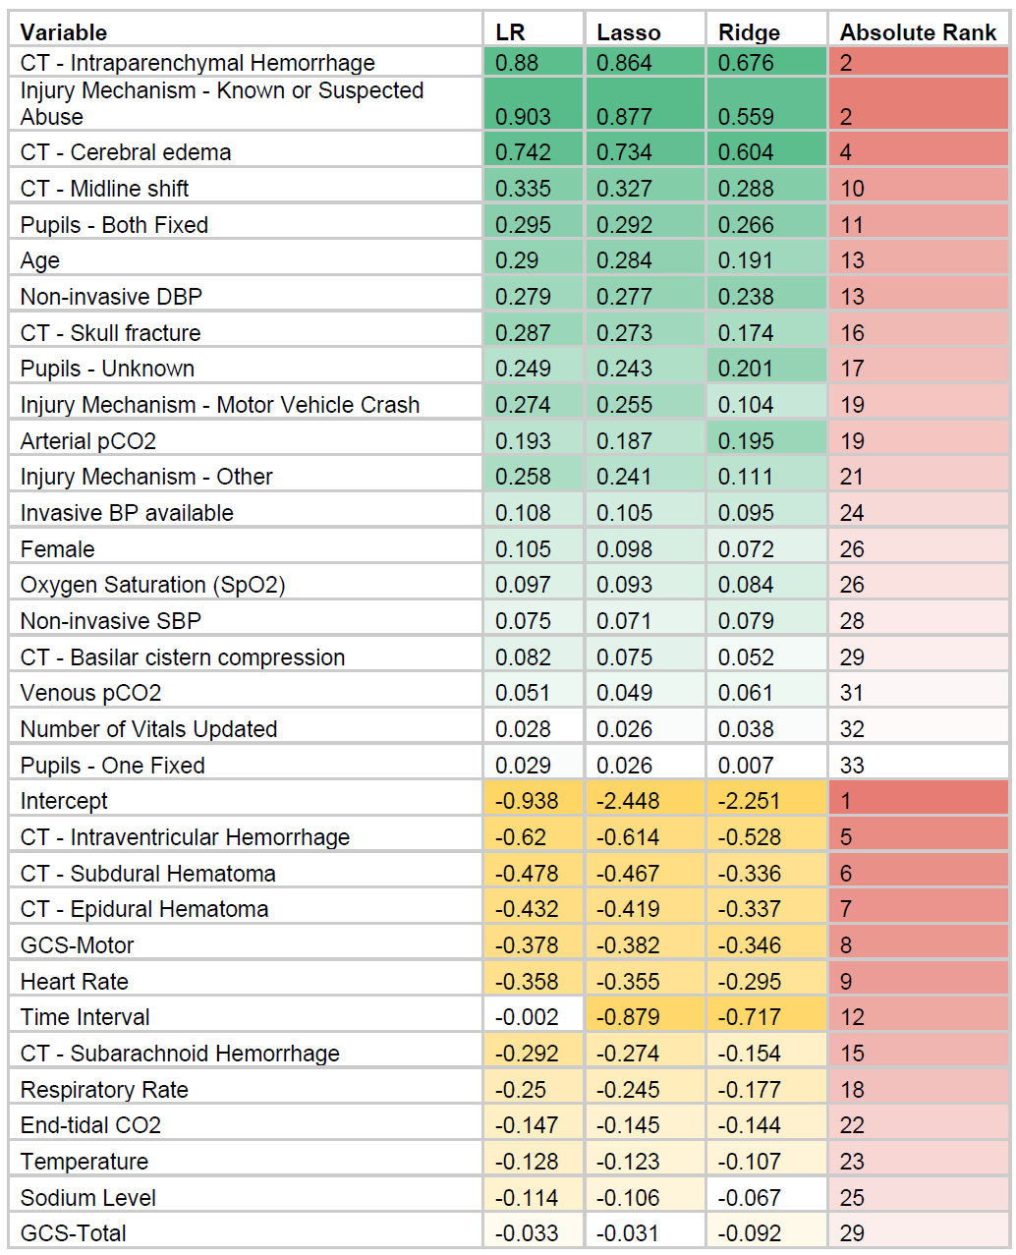
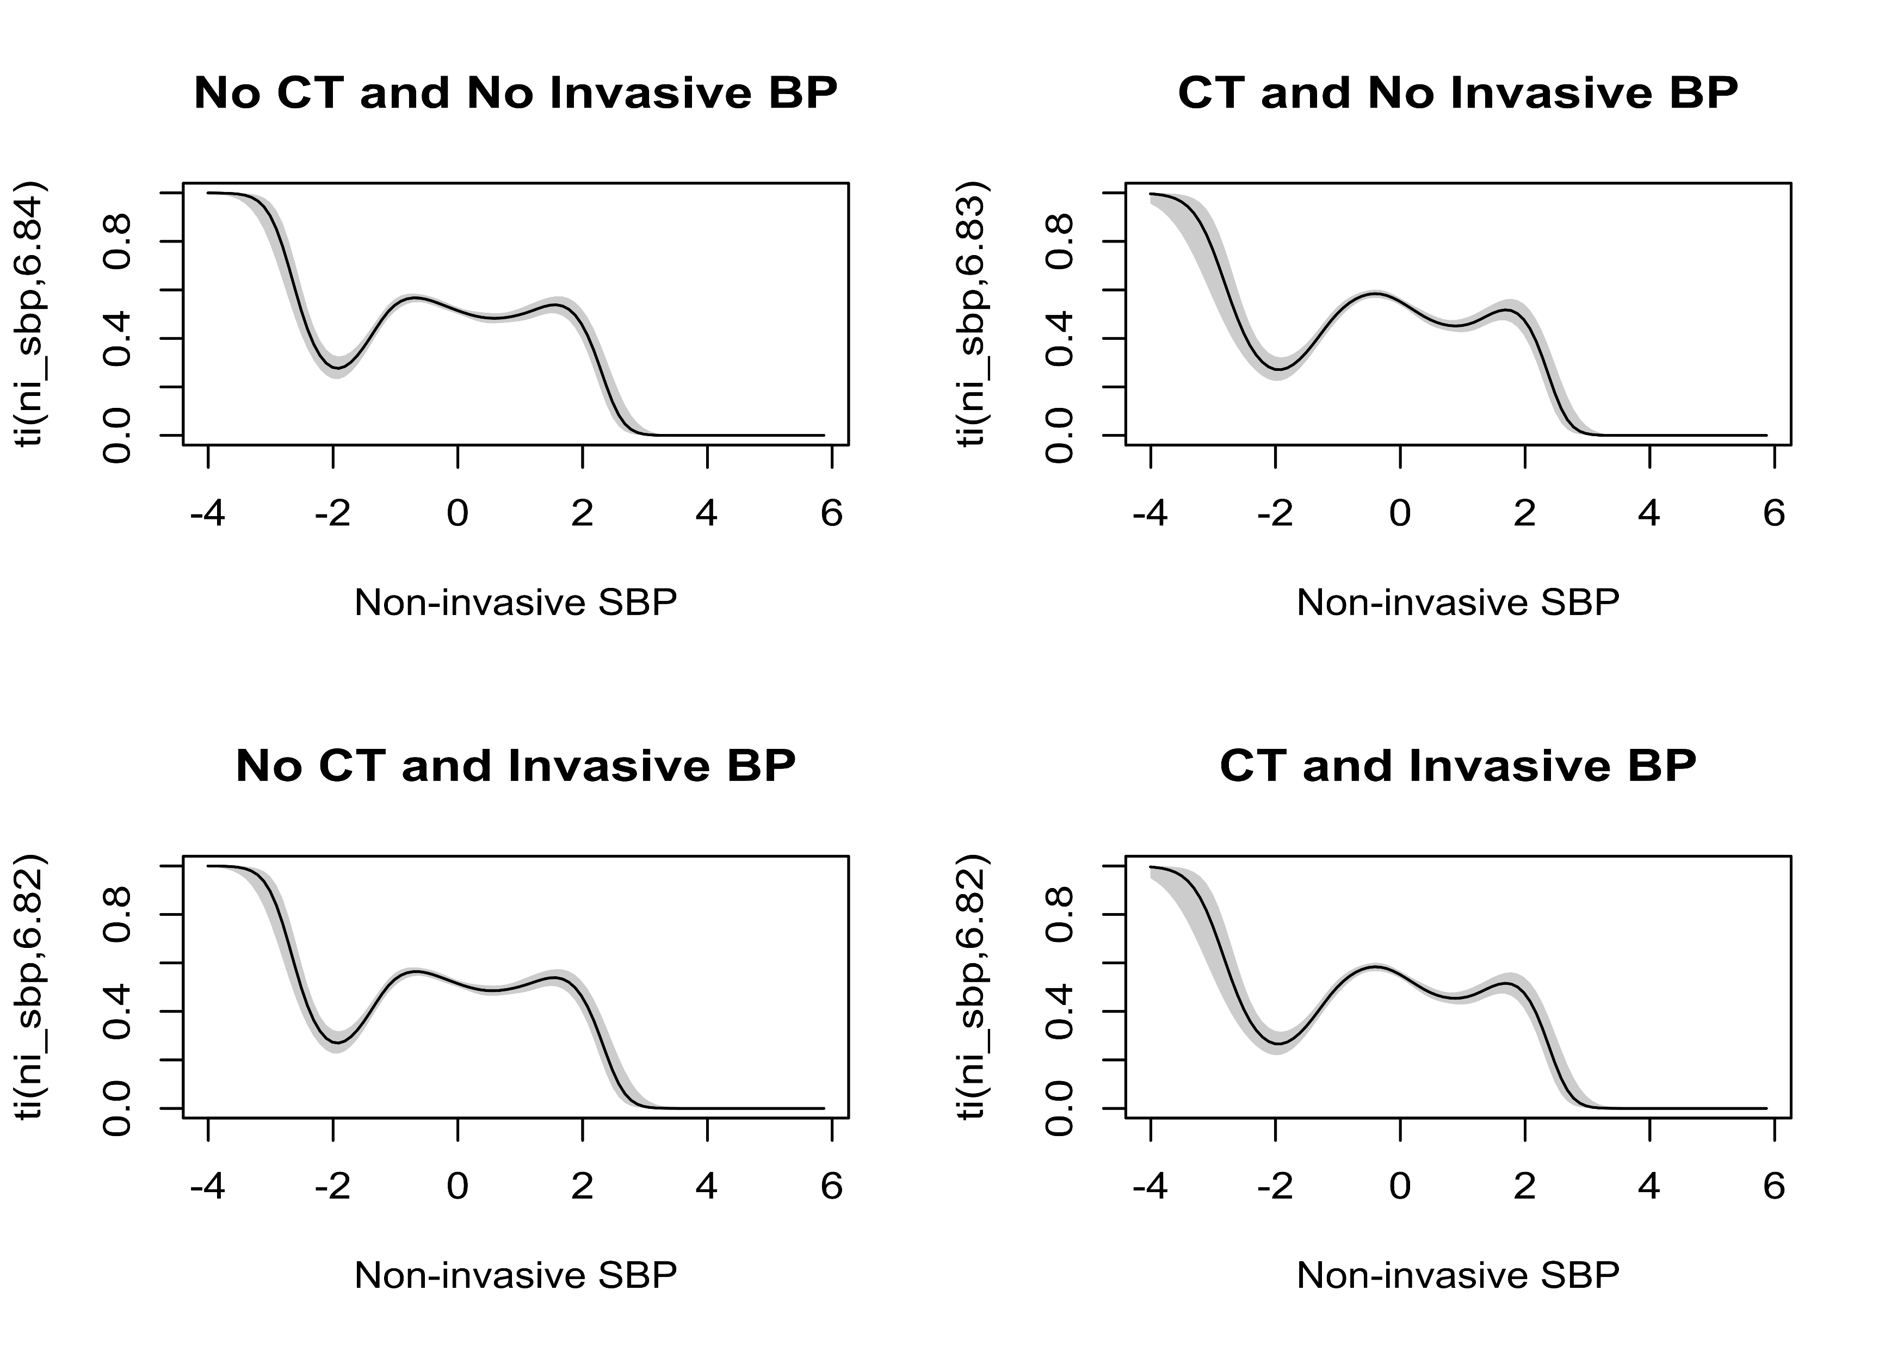
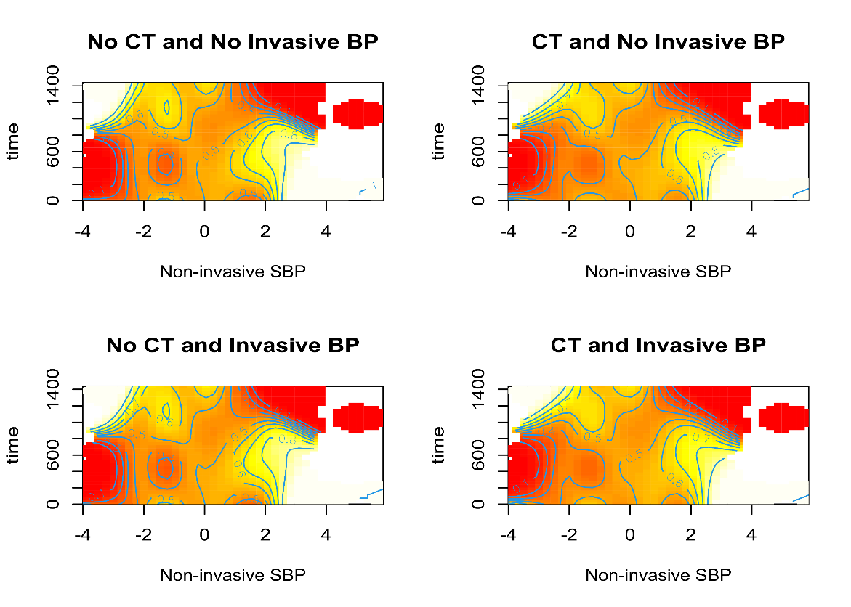

Interpretability - Linear

Slide 22
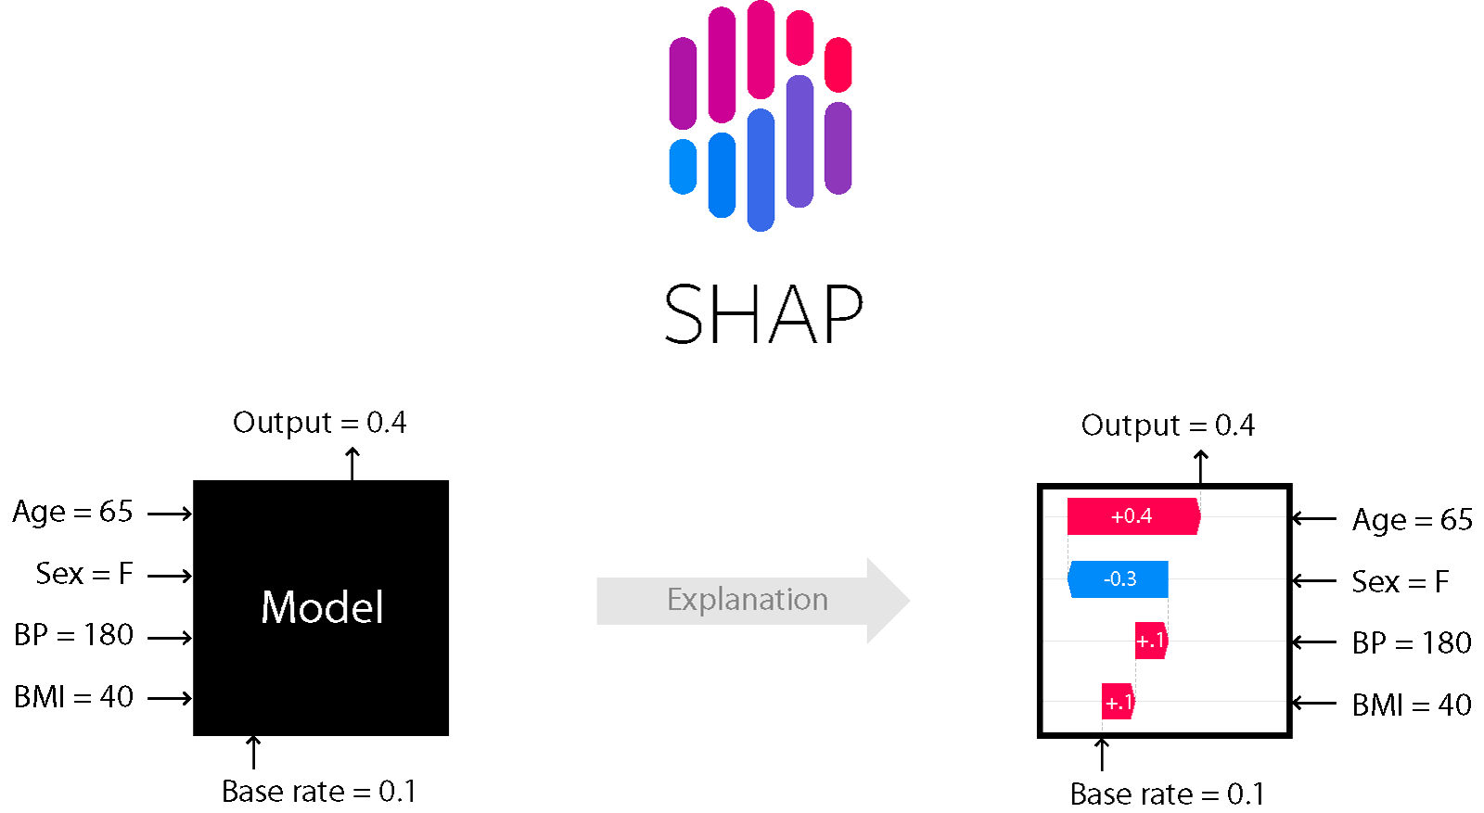

Interpretability - LSTM
https://github.com/magic-lantern/2025-useR

Slide 23
Questions?
Slides available at:
https://github.com/magic-lantern/2025-useR

